Slide 1
Grow in Grace
Leader’s Guide
PP-5—PP-7

Slide 2
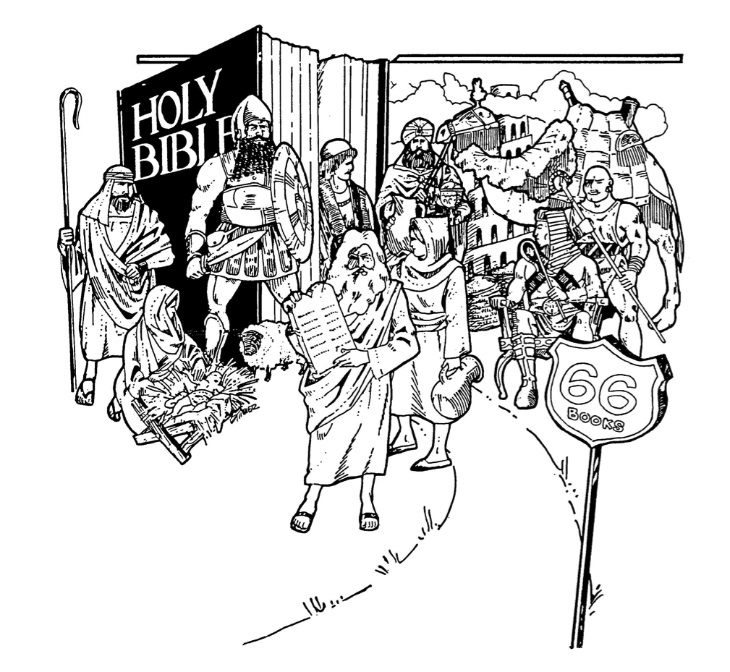
PP-5 Journey Through The Bible

Slide 3
PP-6 Old Testament
Law
Genesis
Exodus
Leviticus
Numbers
Deuteronomy
History
Joshua
Judges
Ruth
1 & 2 Samuel
1 & 2 Kings
1 & 2 Chronicles
Ezra
Nehemiah
Esther
Wisdom & Poetry
Job
Psalms
Proverbs
Ecclesiastes
Song of Songs (Solomon)
Prophetic
Isaiah
Jeremiah
Lamentations
Ezekiel
Daniel
Hosea
Joel
Amos
Obadiah
Jonah
Micah
Nahum
Habakkuk
Zephaniah
Haggai
Zechariah
Malachi

Slide 4
PP-7 New Testament
Gospels
Matthew
Mark
Luke
John
History
Acts
Letters
Romans
1 & 2 Corinthians
Galatians
Ephesians
Philippians
Colossians
1 & 2 Thessalonians
1 & 2 Timothy
Titus
Philemon
Hebrews
James
1 & 2 Peter
1, 2, & 3 John
Jude
Apocalyptic
Revelation

