Slide 1
Grow in Grace
Leader’s Guide
PP-2—PP-4

Slide 2
PP-2 God Reveals Himself to His Children
Creation
(Ps. 19:1-4; Rom. 1:20)
Scripture
(2 Tim. 3:16)
Special Visitations
(Isa. 6:1-8)
Jesus Christ
(Heb. 1:1-3)
The Holy Spirit
(John 14:15-23)
God’s People
(Gen. 1:26, 27; Matt. 5:16, 48)

Slide 3
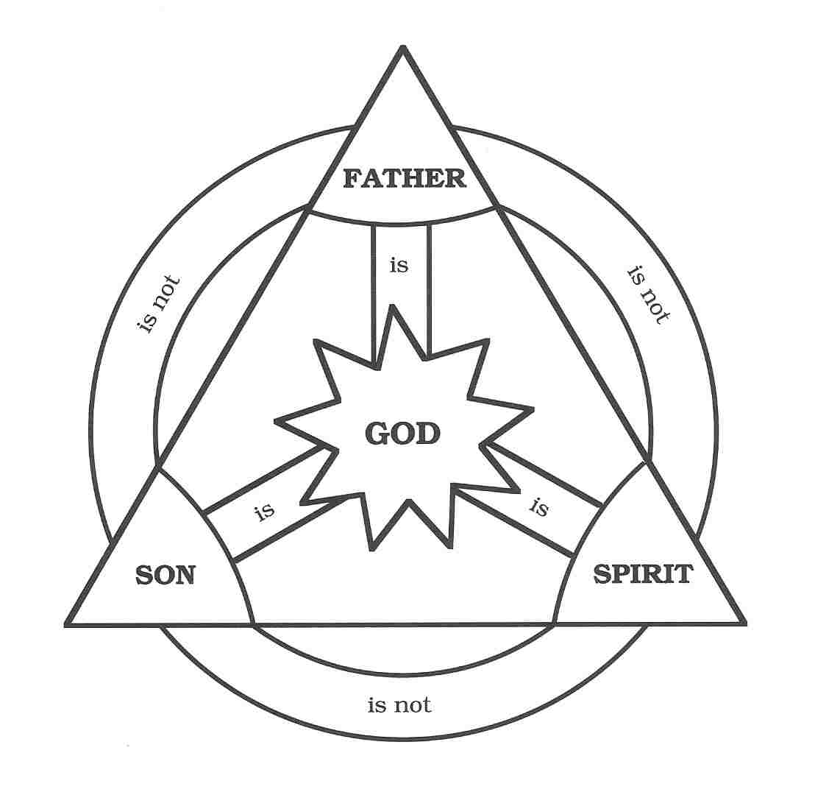
PP-3 The Three-in-One-God
Father
GOD
Son
Spirit

Slide 4
PP-4 The Attributes of God
God is eternal. God has always existed, having no beginning and no end, and experiencing no succession of moments.
God is infinite.
Omnipresent: God has no size or shape and is present in all places with his entire being.
Omniscient: God fully knows Himself and all actual and possible things.
Omnipotent: God is able to do all His holy will.
God is sovereign. God possesses absolute authority over all creation. He is self-existent and self-sufficient and has no need of creation.
God is personal. He is not a force, but a person who thinks, feels, speak, and acts.
God is holy. God is separated from sin and is perfect, and He is committed to seeking His own honor.
God is love. God eternally gives of Himself to others.

